Slide 1


Hotel Reservation Dataset Analysis with MySQL
Banjo Esther Olawunmi
Data Analyst Intern
@

Slide 2
Contents
Overview
Data description
User interface of tool and data cleaning
Data analysis –Questions, Queries and Results
Conclusion
Recommendations

Slide 3
OVERVIEW OF data
The hotel reservation dataset provides a comprehensive view of the booking behaviors and preferences of guests. This data was provided by Mentorness as part of the SQL project to analyze and help hotel management gain valuable insights into customers preferences, pricing strategies, service offerings, meal planning, and customer services for bookings.
The hotel industry relies on data to make informed decisions and provide a better guest experience. In this project, I will be working with a hotel reservation dataset to gain insights into guest preferences, booking trends and patterns, and other key factors that impact the hotel's operations which will help in decision-making and strategy formulation for hotel management. I will use SQL to query and analyze the dataset, as well as answer specific questions about the dataset.
By analyzing this data, hotel management can gain valuable insights into customer segments, optimize pricing strategies, improve service offerings, and ultimately enhance the overall guest experience.

Slide 4
Data description
The dataset includes the following columns:
Booking_id: A unique identifier for each hotel reservation.
No_of_adults: The number of adults in the reservation.
No_of_children: The number of children in the reservation.
No_of_weekend_nights: The number of nights in the reservation that fall on weekends.
No_of_week_nights: The number of nights in the reservation that fall on weekdays.
Type_of_meal_plan: The meal plan chosen by the guests.
Room_type_reserved: The type of room reserved by the guests.
Lead_time: The number of days between booking and arrival.
Arrival_date: The date of arrival.
Market_segment_type: The market segment to which the reservation belongs.
Avg_price_per_room: The average price per room in the reservation.
Booking_status: The status of the booking.

Slide 5
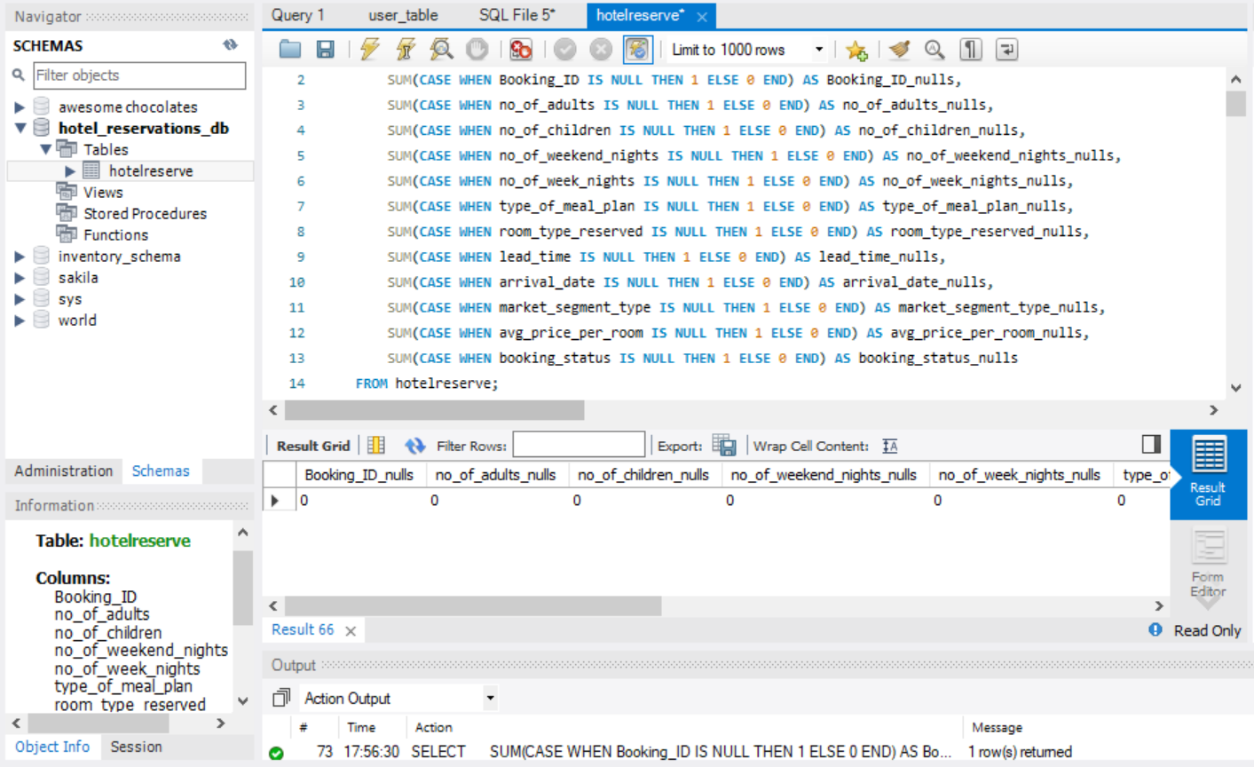
Double-click to activate the database that has the table for the analysis
Click on the “hotelreserve” to show the columns and datatype that are in the table

Slide 6
This pane is where queries are written and run using “ctrl+enter” keys
Results of queries are displayed here in a table format
Actions carried out if correct or wrong are shown here and the details involved

Slide 7
Questions for insights
The following questions are to be analyzed which will help to get insights, and make recommendations;
1. What is the total number of reservations in the dataset?
2. Which meal plan is the most popular among guests?
3. What is the average price per room for reservations involving children?
4. How many reservations were made for the year 20XX (replace XX with the desired year)?
5. What is the most commonly booked room type?
6. How many reservations fall on a weekend?
7. What is the highest and lowest lead time for reservations?
8. What is the most common market segment type for reservations?
9. How many reservations have a booking status of "Confirmed"?
10. What is the total number of adults and children across all reservations?
11. What is the average number of weekend nights for reservations involving children?
12. How many reservations were made in each month of the year?
13. What is the average number of nights (both weekend and weekday) spent by guests for each room type?
14. For reservations involving children, what is the most common room type, and what is the average
price for that room type?
15. Find the market segment type that generates the highest average price per room.

Slide 8
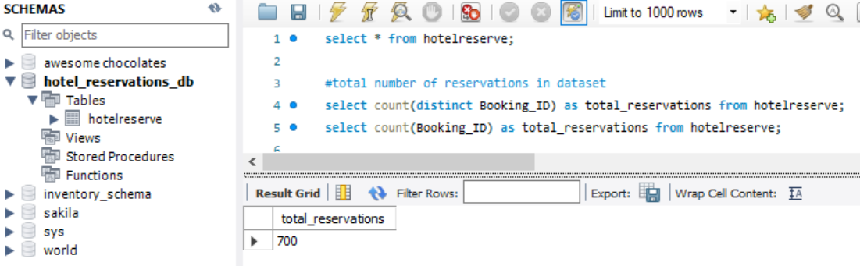
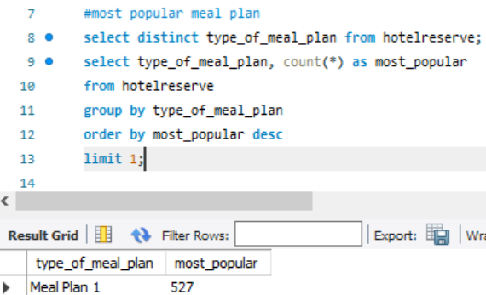
Queries and results for analysis
1. The total number of reservations in the dataset
There are 700 reservations in total in the dataset analyzed with no duplicate values
2. The most popular meal plan among guest
Guests most preferred meal plan is the “Meal plan 1” which has the highest number of order across the types of meal plan

Slide 9
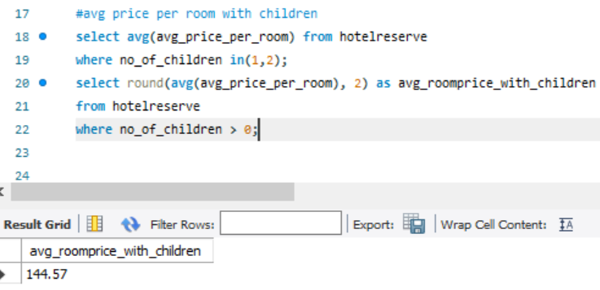
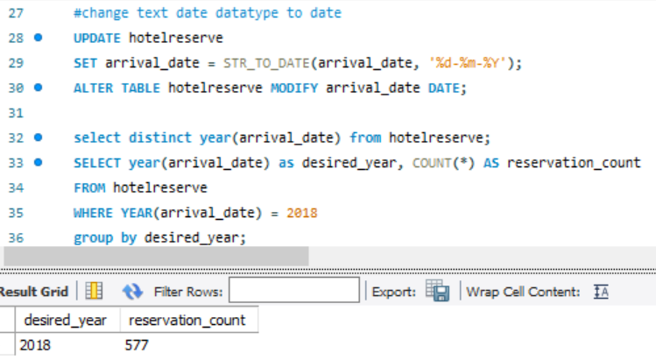
3. The average price per room for reservations involving children
The average price per room involving children rounded up to whole number is $145
4. Reservations made for the year 2018
The dataset covers from 01-07-2017 to 31-12-2018, and my desired year in question is 2018. This then result in having 577 reservations for the year 2018.

Slide 10

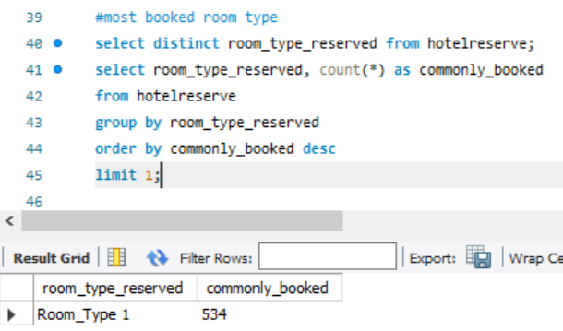
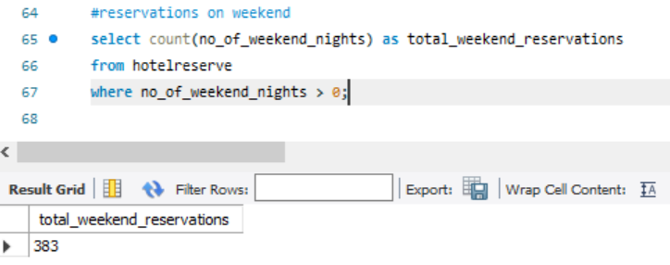
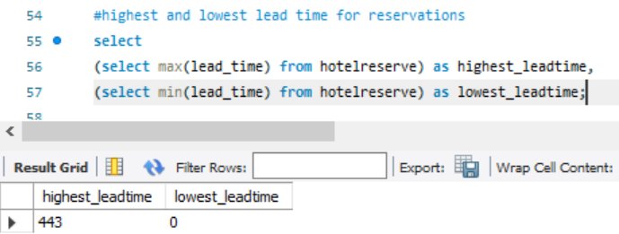
5. The most commonly booked room type
The most room booked room type by guests for reservation is the “Room_Type_1”
6. Reservations on weekends
It was observed from the analysis that bookings on weekend is 383 which means approximately 55% of the reservations in the dataset include weekend nights.
7. The highest and lowest lead time for reservation
The lead time in the dataset ranges from 0 to 433

Slide 11
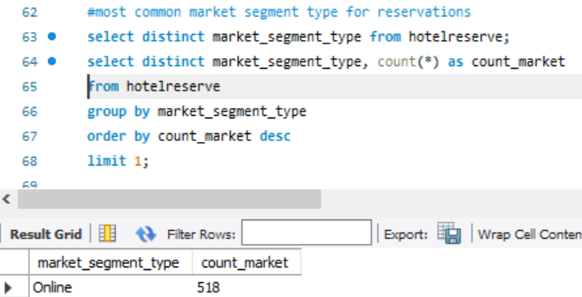
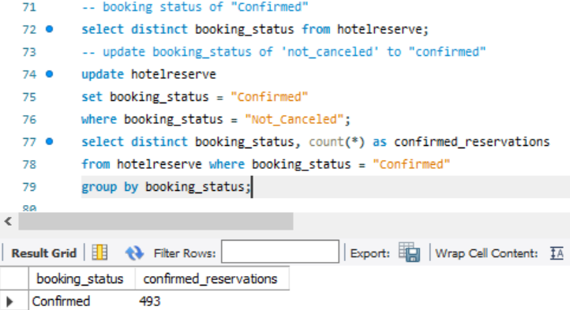
8. The most common market segment type
The most common market segment type is the ONLINE segment type
9. The reservations with a booking status of “Confirmed”
493 booking status was recorded to be “Confirmed”

Slide 12
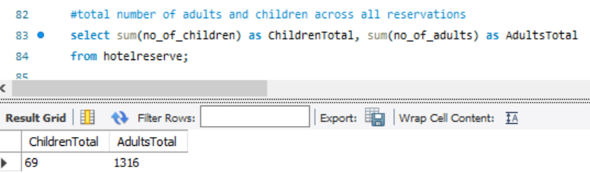
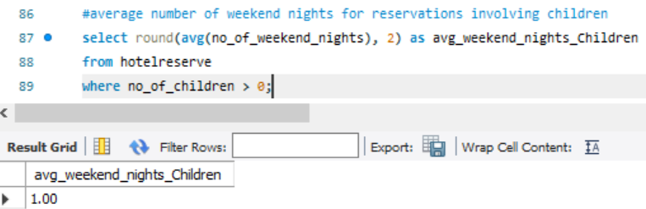
10. Total number of children and adults across all reservations
This gave an insight that across all reservations, adult(1316) are way more than children(69) and they are much more around than children
11. The average number of weekend nights for reservations involving children
The average number of weekend nights with kids is 1

Slide 13
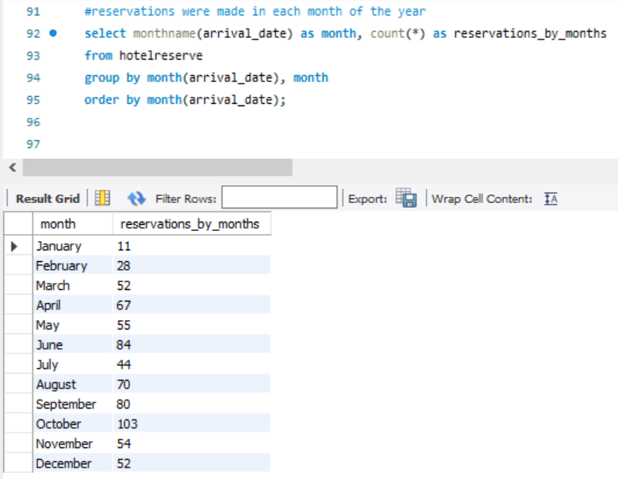
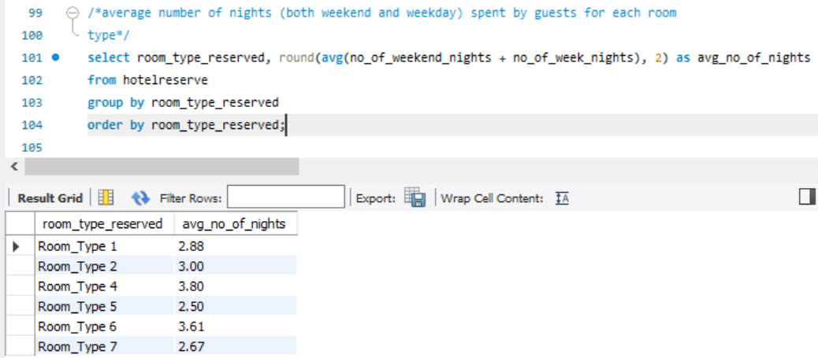
12. Reservations made in each month of the year
The result here shows the reservation made in each month of the year and having the month of October to be the highest month to have more guests in the hotel
13. The average number of nights (both weekend and weekday) spent by guests for each room type?
Taking the sum for both columns involved and getting their average shows the average number of nights spent by guests and the corresponding room type used

Slide 14
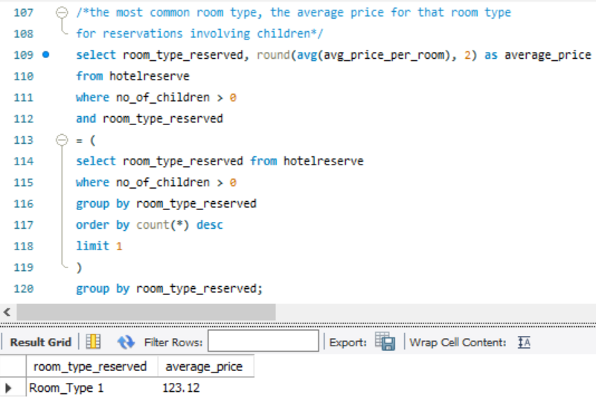
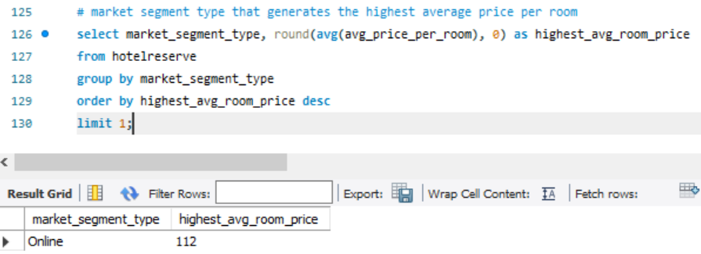
15. The market segment type that generates the highest average price per room.
14. The most common room type, the average price for that room type for reservations involving children
The average price for the most common room type for reservation involving children is “Room type 1” with an average price of $123.12
The highest average room price is generated by the “online” market segment with a record of $112

Slide 15
Conclusions
This data analysis project has provided significant insights into the hotel's reservation patterns, guest preferences, and market trends. By leveraging the "hotel reservation dataset," we identified key factors influencing booking behavior and potential areas for operational and strategic improvements. The analysis highlights the importance of data-driven decisions in enhancing revenue management, optimizing guest experience, and improving overall hotel performance.
Key findings include:
The most popular meal plan and room types.
The number of reservations across different years and months.
Insights into average prices, weekend reservations, and the most common market segments.
Days between booking and arrival.
Weekends and weekdays reservations involving children.
These insights offer a clear roadmap for strategic actions to boost competitiveness and profitability. Also helps the management to be well prepared in offering good services to guests regarding to meal plan preferences, type of room, choice of days, market segment type, and also having kids around.

Slide 16
Recommendations
Adjust room prices:
Change room rates based on demand to maximize revenue, which might include guests having their kids in the same room with them.
Manage room availability to meet guest preferences better.
Improve guest experience:
Use personalized marketing and loyalty programs to attract high-value guests.
Offer family-friendly amenities to encourage repeat bookings.
Customer services on weekends should be looked into, like hiring more staff on weekends will be advisable and beneficial
Optimize revenue management:
Allocate rooms and set prices effectively during peak periods.
Identify and focus on the most profitable guest segments.
Keep tabs on the months that has the most number of reservations over time to prepare ahead.
Make data-driven decisions:
Create a system to regularly analyze data for ongoing improvements.
Use data insights to refine pricing and enhance guest services.
Implementing these steps will help the hotel attract more guests, increase revenue, and provide a better overall experience.

Slide 17


THANK YOU!
– Esther Banjo

